Slide 1


Decision making skills that employers look for………

Slide 2
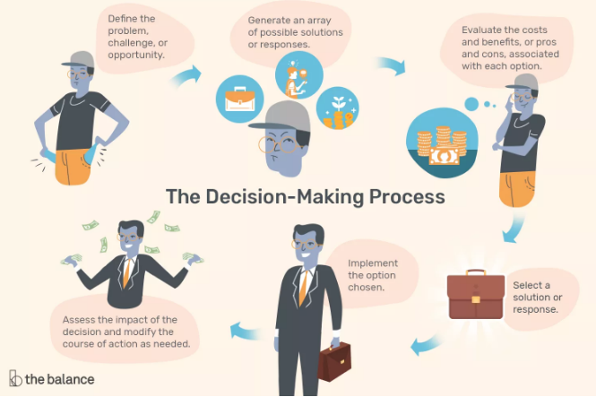
The decision making process
Notes:
Whether deciding which candidate to hire, which consultant to use, or which business plan to execute, the capacity to make the best decision is critical for your organization. Organizational culture and leadership style together determine the process of decision making in any company. Some may use a consensus-based approach, while others depend on a manager or management group to make all major decisions for the company. Many organizations use a mixture of centralized and consensus-based styles. How an individual employee participates in the decision-making process depends on his or her position within the overall structure of the company.
The Decision-Making Process :
A good way to make the most informed decision is to follow a process that assures you are taking into account all relevant information and considering each of the most probable outcomes. A step-by-step checklist like this is valuable for that purpose: Define the problem, challenge, or opportunity. Generate an array of possible solutions or responses. Evaluate the costs and benefits, or pros and cons, associated with each option. Select a solution or response.
Implement the option chosen. Assess the impact of the decision and modify the course of action as needed. You will not always find yourself going through all six steps in an obvious way. You might be responsible for one aspect of the process but not the others, or several steps might be merged, but someone still should go through each step in some way or another. Skipping steps usually leads to poor outcomes. Remember to develop strategies to ensure that you have not overlooked important information or misunderstood the situation, and be sure to uncover and correct for any biases you may have.

Slide 3

Types of decision making skills
Problem solving.
Collaborative.
Emotional intelligence.
Logical reasoning.
Notes:
Even if you do not yet have management experience, you probably have made decisions. Because decision making is not always a cut-and-dried process, though, you might not have recognized what you were doing. These examples provide a sense of what activities from your own history you can share with potential employers to demonstrate your decision-making skills. Be sure to keep your sharing as relevant to the job requirements for the position as possible. Decision making skills are broadly classified as problem solving,Collaborative,Emotional intelligence and Logical reasoning.

Slide 4
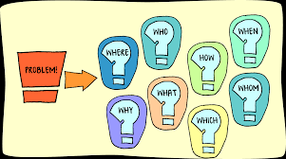
Problem solving skills
Brain storming.
Creative thinking.
Data analysis.
Data Gathering.
Fact finding.
Notes:
Problem Solving :
Finding the best solution when faced with a problem is of utmost importance and taking a measured approach will help you get there. Having the ability to problem solve thoughtfully and logically while incorporating different perspectives is key. Leaving your emotions at the door also allows you to look at the problem from every angle. Regardless of your field, you will be faced with many problems. Those of us who don’t let this fact overwhelm us will thrive in our chosen careers. This includes various parameters to be taken into account. Active Listening, Benchmark Development,Brainstorming,Causal Analysis,Collaboration,Creative Thinking, Data Analysis, Data Gathering,Discussion,Fact Finding,Forecasting,Historical Analysis,Mediation,Needs Identification,Prediction,Prioritizing,Process Analysis,Project Implementation,Project Management,Project Planning,Teamwork,Test Development, Time Management. Trainer can explain each and individual criteria to the students one by one.

Slide 5

Collaborative
Authenticity.
Asking for feedback.
Embracing differences.
Processing ideas.
Reliable.
Notes:
There are going to be times when you will need the input of others to come to a decision. You will need to recognize when decisions need collaboration and then foster team meetings to come to the best decision. Being able to communicate your goals clearly and welcome feedback are central to a collaborative environment. Parameters involved in collaborative decision making skills are Active Listening, Authenticity, Asking for feedback,Brainstorming,Clear Communication,Compromising,Embracing Differences,Honest Feedback,Knowledge Sharing,Motivation,Organized,Processing Ideas,Reliable,Setting Expectations,Team-Building Activities,Teamwork,Team Player. There are circumstances where you have to listen to others before taking decision . How well you analyze the ideas and opinions given by others matters in collaborative decision making. Asking for other’s ideas and opinions and analyzing the pros and cons of their ideas to figure out what will work out and what won’t is a skill to be acquired. Trainer can add their own points in order to explain each and every parameter involved.

Slide 6
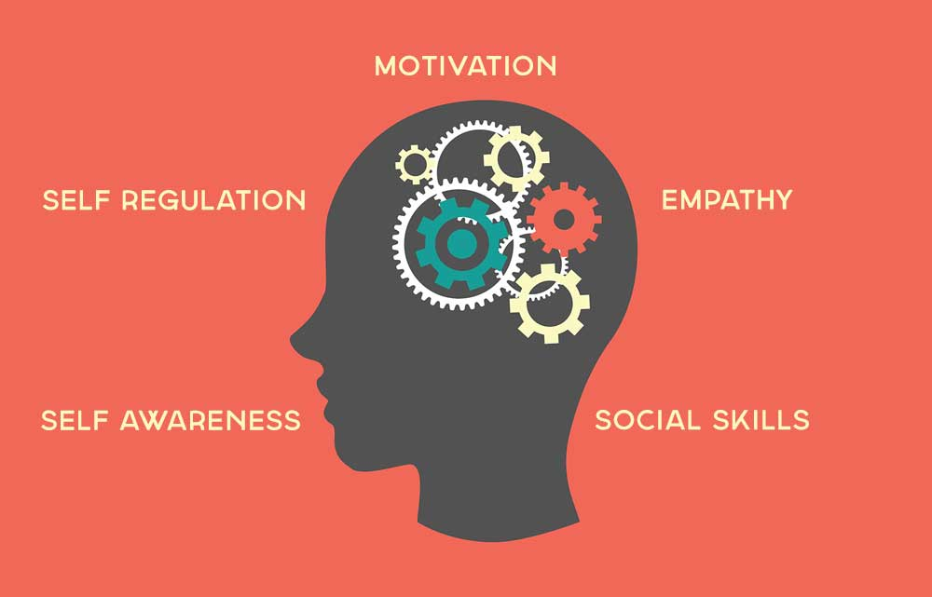
Emotional Intelligence
Empathy.
Interpersonal.
Self awareness.
Self regulation.
Social skills.
Notes:
Having high emotional intelligence means being aware of, having control over, and expressing your emotions in a healthy and measured manner. It is important to not let your emotions take over when coming to an informed decision. Especially when you are working with others to come to a decision central to the decision-making process, you will need to control your emotions to effectively convey your opinions. The parameters that will influence your emotional intelligence are Active Listening,Collaboration,Empathy,Interpersonal,Motivation,Patience,Self Awareness, Self Regulation, Social skills. Trainer can add his/her own points to elaborate each parameter in detail.

Slide 7
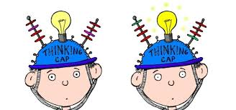
Logical Reasoning
Analytical.
Conceptual.
Critical thinking.
Curiosity.
Deductive reasoning.
Notes:
In order to come to an informed decision, you will need to look at all the facts presented to you. This is where logic comes in. Weighing all the advantages and disadvantages of your actions is at the core of every measured decision. Your emotions will need to take a back seat in order to avoid compromising your rational decision making. For example, if a colleague with whom you have a close working relationship has been accused of harassing another employee, it is imperative you remove your emotions to move forward fairly. Parameters that will help in building logical reasoning skills are Consulting, Cost Analysis, Critical Thinking,Curiosity,Data Driven, Deductive Reasoning, Emotional Regulation, Evidence Based, Fact Based, Independent Thinking, Information Gathering, Managing Emotions,Planning,Problem Solving,Rationale,Reflective Learning,Research,Risk Assessment,Scientific Analysis, Self Awareness, Self Control, Teamwork.

Slide 8
What decision will you make?
1.You are a supervisor in a life skill enhancement program for youth with a diagnosis of autism. You have recently assigned your social work intern, Sarah, to work on social skills with a 15-year-old client, Margaret, who has self-identified as transgender for two years. Sarah is an excellent intern and you are glad to have her because the agency is seriously short-staffed right now. Sarah comes to you to say that she doesn’t think transgender “is a real thing” and that it is a mental disorder. She says she will feel uncomfortable around Margaret and doesn’t feel qualified to work with her. She requests that you assign Margaret to someone else.
Notes:
Split the class into teams and give some time . Ask each team to come up with different decisions. Discuss pros and cons of each of their decisions.

Slide 9
2. You are an MSW-level manager of several programs at an agency that provides a variety of services to people with physical or intellectual disabilities. Five of your staff recently went to Winnipeg over the weekend for a bachelorette party for one of them, Tamara, who is leaving the area after getting married. The group of friends stayed at a resort, gambled, went to shows, and enjoyed exotic cocktails. Tamara posted some pictures from the trip on her Face book page. The site is private, with access exclusively for family and friends of the bride and groom. Today, the groom’s uncle, who is on the board of directors of your agency, called you to complain about the morals of the agency’s staff. He had been to the site and was offended by the group’s “lascivious behavior.” He told you that “as a member of the board, I’m embarrassed by their behavior and they make the agency look bad. I expect you to take action.”
Notes:
Split the class into teams and give some time . Ask each team to come up with different decisions. Discuss pros and cons of each of their decisions.

Slide 10
THANK YOU

